Slide 1
﻿Inequality and government policy
Governments aim to maximise social welfare
social welfare is the level of well being in society
it is determined by both how much gets produced and how it is distributed
Government can increase social welfare
when it can increase social efficiency (correct market failure)
OR
when it can achieve a more preferred distribution of resources

Slide 2
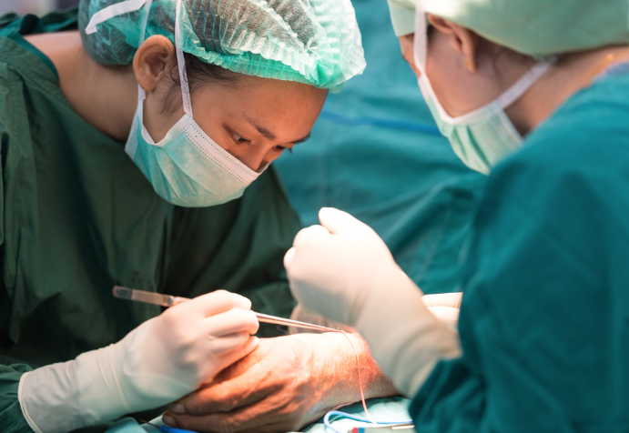
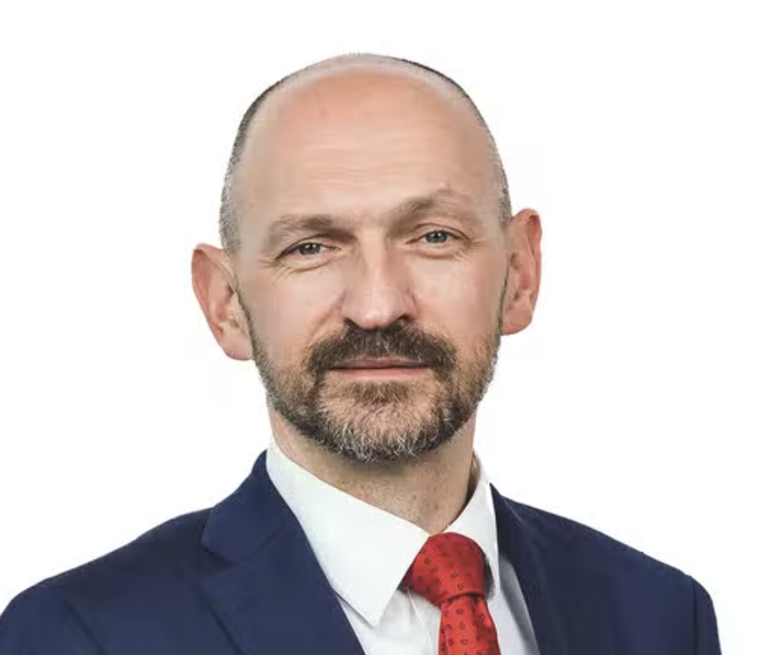
﻿What are views on inequality?
When asked "Would you say that the gap between those with high incomes and those with low incomes is too large, about right or too small?"
80% of Britain's say it was too large
Most people are happy with some degree of inequality (almost no one believes that everyone's income should be exactly the same)
differences in opinion often depend on why they think the differences arise

Slide 3
﻿Inequality is not the same as poverty
share of households
poverty line
poverty is when a household's material resources aren't enough to mean their minimum needs
inequality is a measure of the gap between the rich and poor, it is bout how spread out the distribution is
income

Slide 4
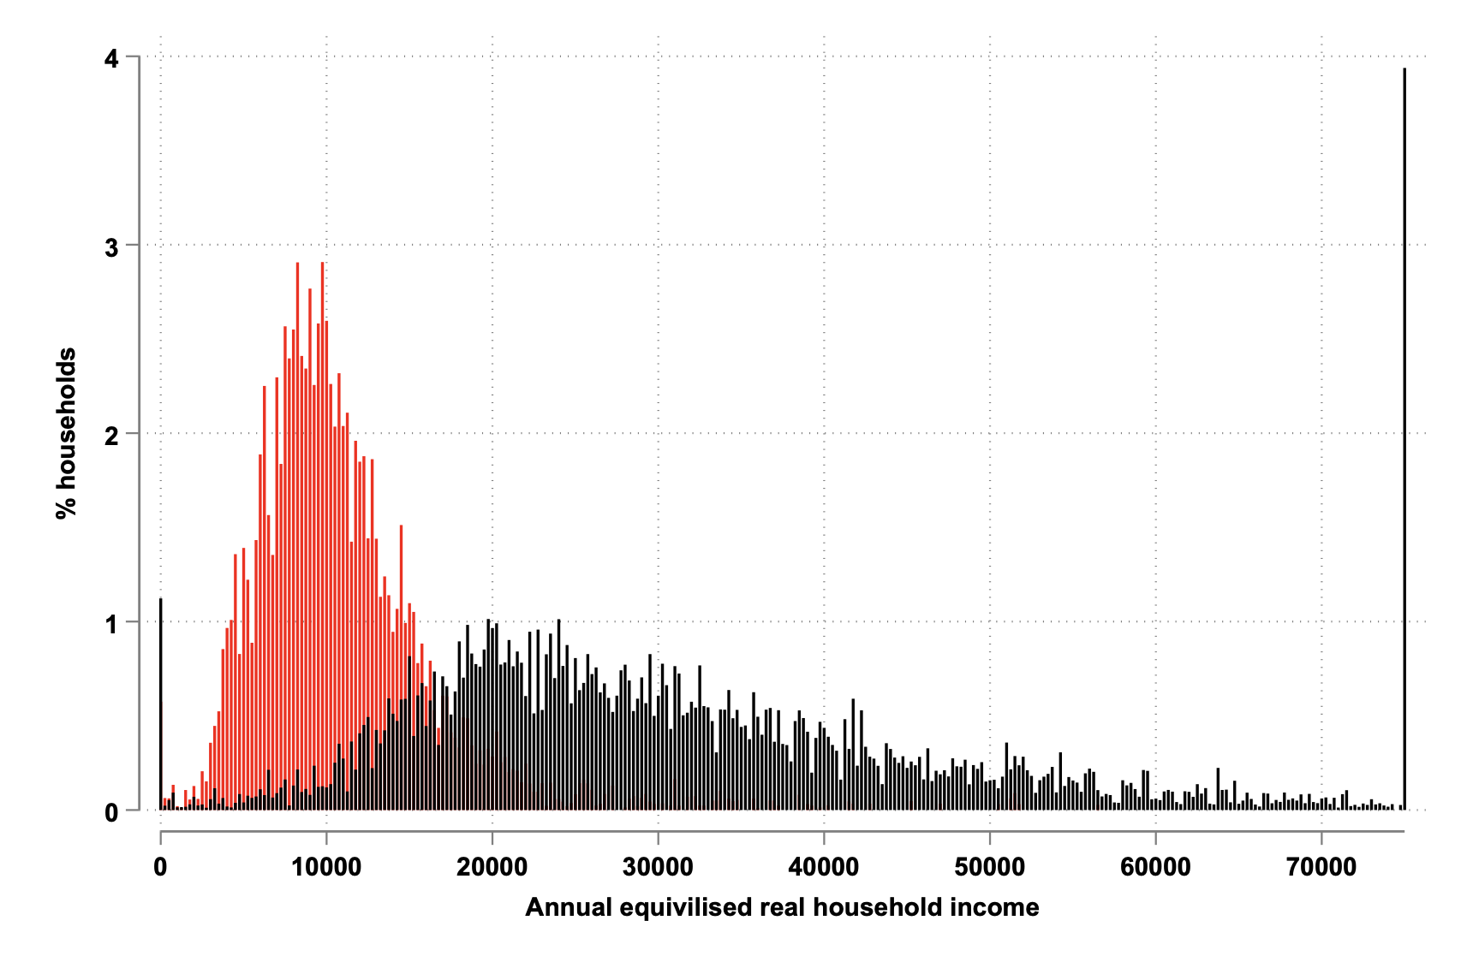
﻿Income levels and inequality in the UK
Over the 50 years before the pandemic incomes in the UK increased
resulting in less poverty
but the growth at the top of the income distribution has been stronger than at the bottom
leading to more inequality
red bars are 1961
black bars are 2020

Slide 5
﻿Income inequalities translate into other inequalities
The lack of economic opportunity translates into poor social and health outcomes
a female living in the richest area is expected to live almost 8 years longer than someone living in the most deprived area
children growing up in deprivation are more likely to be obese, which has long term adverse health and social consequences
children growing up in deprivation achieve worse educational outcomes
less educated people are increasingly less likely to be living in a stable family situation

Slide 6
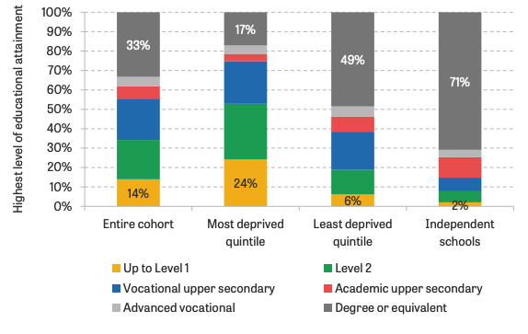
﻿Inequalities in educational outcomes
Share of people with a degree more than twice as high now as 30 years ago
but, there are large inequalities in educational attainment between children from different social and economic backgrounds
Source: Figure 33 in Farquharson, McNally and Tahir (2022)

Slide 7
﻿What does the government do to address inequalities?
Taxes
taxes are progressive, meaning that higher income households pay proportionally more than lower income households
Benefits
means-tested benefits provide support to low income households
Spending
many forms of government spending, such as healthcare and education, provide universal benefits that support everyone, but typically are of more value to lower income households

Slide 8
﻿Policy redistributes from rich to poor
Source: Figure 5 in ONS (2022)

Slide 9
﻿People's views on redistribution
Many people in the UK (around 80%) say they are worried about inequalities
but much less support for additional redistributive policy through the direct means of taxation and income transfers
there is more support for some specific and less direct means of redistribution, such as the NHS and for funding of children from poorer families to go to university.
Many people believe that effort should be rewarded
the British are more likely than other Europeans to agree that ‘large differences in people’s incomes are acceptable to properly reward differences in talents and efforts’

Slide 10
﻿Policy can redistribute and predistribute
Redistributive policies
after income is earned we take is away from high income households and redistribute to low income households
but quite a bit of that is within a person over their lifetime
Pre-distributive policies
Can policy instead intervene before income is earned (pre-production) to increase incomes at the bottom, and moderate incomes at the top, so that not so much inequality arises in the first place
e.g. education is pre-distributive

Slide 11
﻿Policy can redistribute and predistribute
Income level | pre-production stage | production stage | post-production stage
Bottom incomes | primary education, early childhood interventions | in-work benefits, (minimum wage) | means-tested benefits
Middle incomes | subsidies to higher education, retraining | minimum wages, union policies | unemployment insurance, pensions
Top incomes | inheritance taxes | competition policy | top income taxes, wealth taxes
Source: based on Stantcheva (2021)

Slide 12
Summary
Incomes in the UK were rising (until the pandemic), resulting in less poverty, but more inequality
Income inequality has been associated with other social and economic problems
Government policy redistributes from the poorest to the richest, and redistributes from times in people lives when they are richer to when they are poorer
The UK does poorly by international comparison in terms of pre-distribution
the income and education of parents is strongly associated with their children's income and education when they grow up
results in a lack of equality of opportunity

Slide 13
Further reading
Joyce, R (2017) Who got richer over the last 50 years? IFS video (1:26) explains that we're richer than we were 50 years ago, with fewer people living on very low incomes, but inequality - the gap between rich and poor - is much larger
IFS tool: Where do you fit in the income distribution? , let's you input a household's income and see where they fit in the UK income distribution, try putting in different levels of income (just enter 0 for council tax) and see where they are in the income distribution - this will help you understand something about the existing distribution of income in the UK
ONS (2022), "Effects of taxes and benefits on UK household income" shows you how taxes and benefits affect the net income of households at different points in the income distribution
Benson, Duffy, Hesketh and Hewlett (2021) "Attitudes to inequalities", chapter for the IFS-Deaton review summarise public views in the UK about income inequality and redistribution
Farquharson, McNally and Tahir (2022), see IFS Deaton Review, Education inequalities page, an dthe summary page of Farquharson, C., McNally, S., Tahir, I., (2022), ‘Education Inequalities’, IFS Deaton Review of Inequalities,
Stantcheva (2021) "What different ways can policy-makers address inequality?" The Economics Observatory
The IFS-Deaton Review into inequalities has documented the extent of these

