Slide 1
The gender gap in the labour market
Rachel Griffith

Slide 2
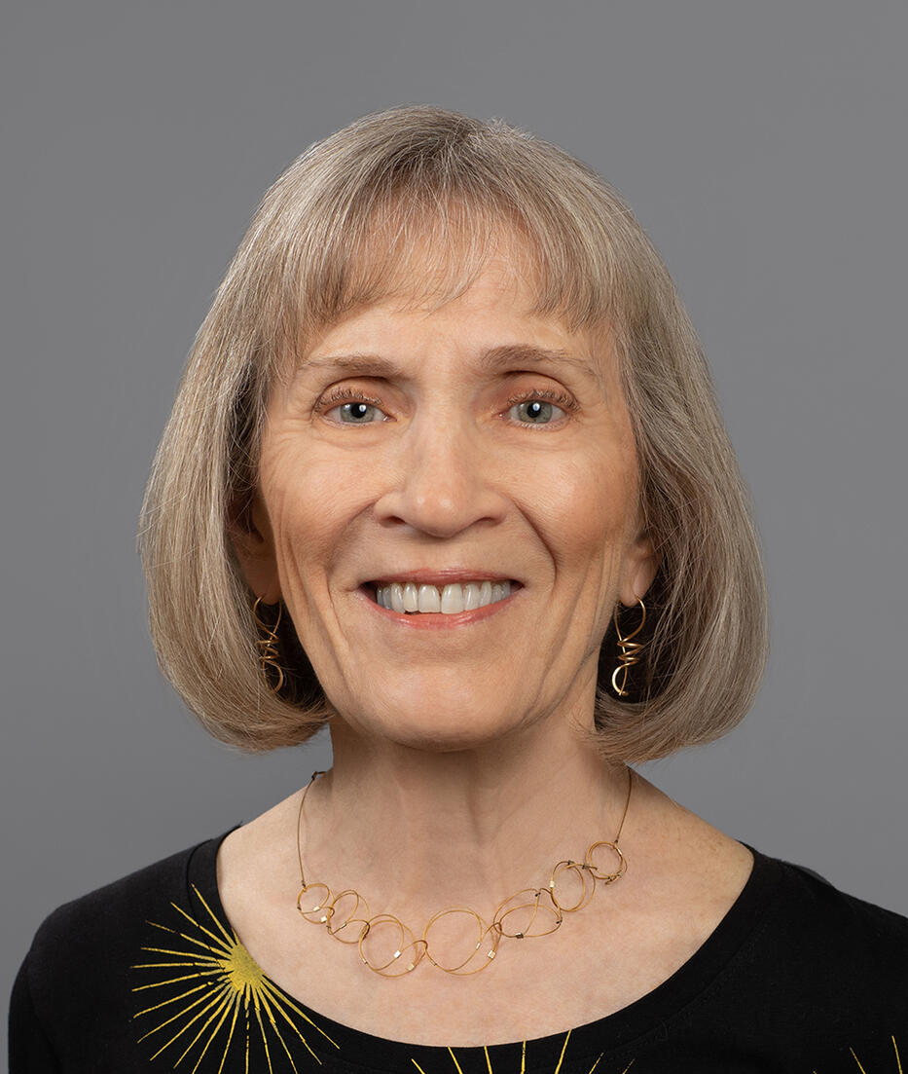
Claudia Goldin
won the Nobel Prize this year
  she provided the first comprehensive account of women’s earnings and labour market participation through the centuries. Her research reveals the causes of change, as well as the main sources of the remaining gender gap.
3rd women to win
1st to win solo
Source: https://www.nobelprize.org/prizes/economic-sciences/

Slide 3


The gender gap in earnings in the UK
The average working age woman in the UK earns
40% less than the average working age man
£6,000
£10,000
Source: https://ifs.org.uk/inequality/women-and-men-at-work/

Slide 4
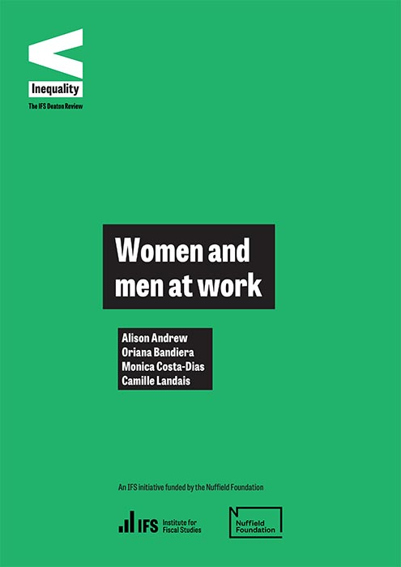
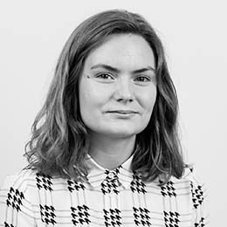



Women and men at work
Alison Andrews, IFS and Oxford
Oriana Bandiera, LSE
Monica Costa Dias, IFS and Bristol
Camille Landais, LSE
https://ifs.org.uk/inequality/women-and-men-at-work/

Slide 5
The gender gap in earnings in the UK
The earnings gap is higher for less educated women
Low (GCSE) average female earns 50% less than male
Medium (A-level) average female earns 45% less than male
High (university) average female earns 35% less than male
Source: https://ifs.org.uk/inequality/women-and-men-at-work/

Slide 6
The gender gap in earnings in the UK
The average working age woman in the UK earns
40% less than the average working age man
gender earnings gap
whether in employment
hours
worked
wages per hour
women are less likely to be in employment
employed women work fewer hours on average
women's wages are on average lower

Slide 7
The gender gap in earnings in the UK
50%
Education:
Source: https://ifs.org.uk/inequality/women-and-men-at-work/

Slide 8
The gender gap in earnings in the UK
50%
45%
35%
Education:
Source: https://ifs.org.uk/inequality/women-and-men-at-work/

Slide 9
Why do we care if women earn less?
Misallocation of latent
  the economy is less efficient because high productivity women aren't participating in the labour market, or are not in the best jobs
Women are more likely to be in poorer households
  and in households with poor children
  increasing women's earnings is one way to reduce poverty and provide equality of opportunity for these children
Women have less bargaining power within the household
  e.g. may increase prevalence of domestic violence
Many other (non-economic) reasons

Slide 10
Why is there a gender gap in earnings?
gender earnings gap
whether in employment
hours
worked
wages per hour
Many possible factors
discrimination in the labour market
decisions over whether to work, and how many hours
choice of education and human capital investments
choice of occupation
time commitments and restrictions, home production
expectations and bargaining over pay and promotion
social norms and expectations of behaviour
....

Slide 11
Why is there a gender gap in earnings?
discrimination
  in the past has been an important factor
  it is now against the law
  though does still happen, in most situations in the UK it is likely not the most important factor

Slide 12
Why is there a gender gap in earnings?
education
  25 years ago the gender earnings gap was 53%
  most (three-quarters) of the reduction in the gap can be explained by the closing of the gender gap in education levels
 | Women | Men
Go into Higher Education | 50.6% | 38.4%
Go into a high tariff university | 12.7% | 10.1%
Achieve a 2st or upper 2nd class degree | 85.0% | 82.4%
Source: https://commonslibrary.parliament.uk/research-briefings/cbp-9195/

Slide 13
Why is there a gender gap in earnings?
choice of occupation
  women are now on average more educated than men
  but only in last 10 years or so
  and women are still less likely to be in the highest earning fields
 | More likely to study
Women | Veterinary science, education, subjects allied to medicine, psychology, languages
Men | Engineering and technology, computing, maths, architecture/planning, business/management, economics

Slide 14
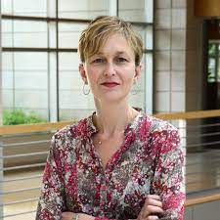
Why is there a gender gap in earnings?
women are more cautious and less likely to take risks
  lab experiments show women are more risk-averse
  so less likely to take jobs that are high risk where salaries are highest, and less likely to bargain hard for higher pay
  but evidence suggests this isn't that important in explaining earnings gap
  and are these traits inherent or learned?
Marianne Bertrand, University of Chicago
Source: https://bfi.uchicago.edu/wp-content/uploads/WP_2018-38.pdf

Slide 15
Why is there a gender gap in earnings?
Women demand more flexibility, largely for reasons to do with family and children
decisions over whether to work, and how many hours
choice of job
time commitments and restrictions
Higher-paying jobs tend to involve long hours and inflexible schedules, and continuous labor force attachment in order to stay on the “fast track”
makes it difficult to combine those careers with job interruptions due to having and taking care of children
Source: https://bfi.uchicago.edu/wp-content/uploads/WP_2018-38.pdf

Slide 16
Why is there a gender gap in earnings?
Source: https://www.nobelprize.org/prizes/economic-sciences/

Slide 17
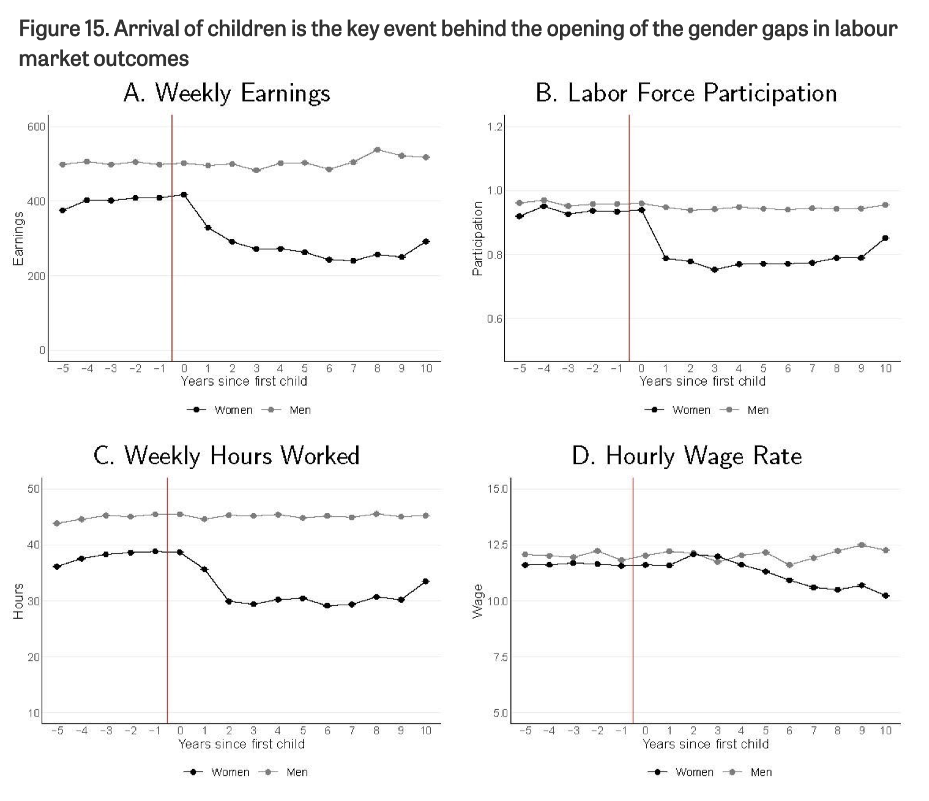
The arrival of children has a big impact
Source: https://ifs.org.uk/inequality/women-and-men-at-work/

Slide 18
The arrival of children has a big impact
Source: https://ifs.org.uk/inequality/women-and-men-at-work/

Slide 19
Why do women work less?
This could be an optimal response by households to financial incentives
when they have a child is requires care and someone has to take time off work
if the male earns more than the female then this makes financial sense

Slide 20
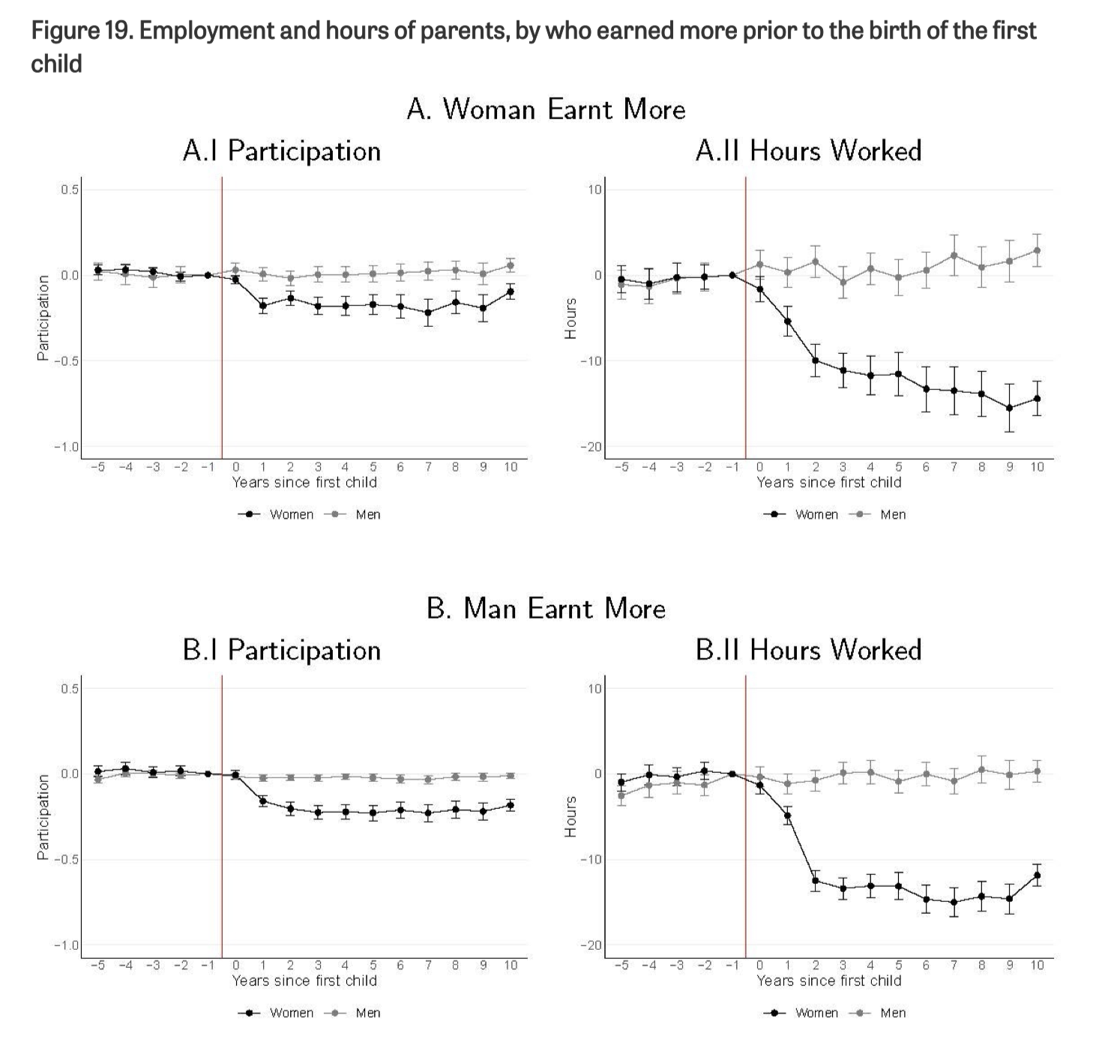
but we see the same figure even when financial incentives are for women to keep working
Source: https://ifs.org.uk/inequality/women-and-men-at-work/

Slide 21
but we see the same figure even when financial incentives are for women to keep working
Source: https://ifs.org.uk/inequality/women-and-men-at-work/

Slide 22
Why is there a growing gap in wages?
Source: https://ifs.org.uk/inequality/women-and-men-at-work/

Slide 23
Why is there a growing gap in wages?
Women less likely to work and work fewer hours
this means they get less experience, wages tend to increase with experience
higher-paying jobs tend to involve long hours and inflexible schedules, and continuous labor force attachment in order to stay on the “fast track”
Women are less likely to progress to better jobs
women don't commute as far as men
meaning they search from a smaller pool of jobs
so may be less well matched to the job they choose

Slide 24
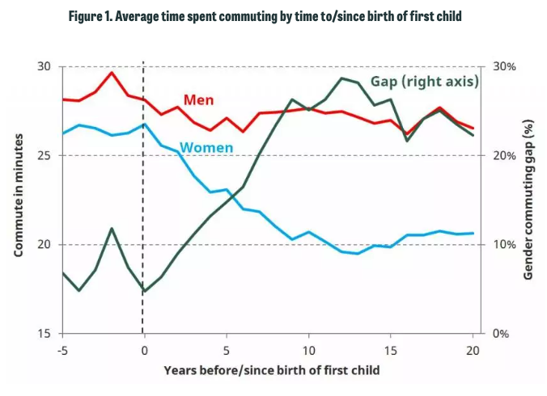


Women work nearer to home
Rob Joyce, IFS
Agnes Norris Keiler,
IFS (now CEP)
Source: https://ifs.org.uk/articles/gender-commuting-gap-widens-considerably-first-decade-after-childbirth

Slide 25
Insights from Claudia Goldin's work
Claudia Goldin pioneered a framework that put women at the centre of the analysis
education, fertility, and productivity are connected to the evolution of women’s aspirations and identity
Women make choices while facing important constraints
the need to balance work for the market with work for the family
Large scale institutional changes have been important
industrialisation and the shift to a market economy
increasing education
the contraceptive pill
Source: https://www.nobelprize.org/prizes/economic-sciences/

Slide 26
Insights from Claudia Goldin's work
industrialisation made it harder for women to combine work and family because they could no longer work from home
Source: https://www.nobelprize.org/prizes/economic-sciences/

Slide 27
Policies to reduce the gender earnings gap
Why today do women still participate less in the labour market and take more responsibility for childcare and home work?
  women's low participation in work and slow career progression is not due to a lack of skills or productive ability
  it is because norms, attitudes and the policy environment combine to reinforce a traditional gendered division of labour, especially upon parenthood
  https://ifs.org.uk/inequality/women-and-men-at-work/
  there are many drivers of the gender earnings gap that interact; policy that target only one channel are likely to be ineffective
  social norms of behaviour and expectations play an important role, they are changing but slowly
  https://www.nobelprize.org/prizes/economic-sciences/
Notes:
Source: https://ifs.org.uk/inequality/women-and-men-at-work/

Slide 28
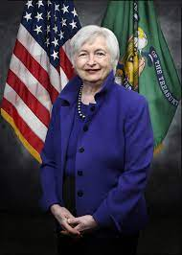


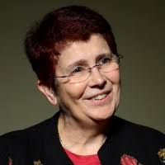
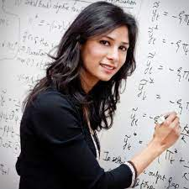
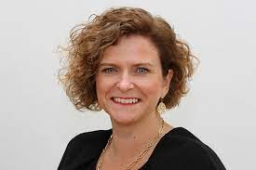

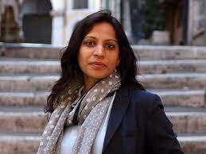
To end on a positive note – some of the women in top positions in economics
Sharon White
Chair John Lewis
Mariastella Botticini
President European
Economic Association
Mary Morgan
President Royal
Economic Society
Janet Yellen
US Secretary of Treasury
Gita Gopinath
Chief Economist IMF
Sam Beckett
Chief Economic Adviser
HM Treasury
Swati Dhingra
Monetary Policy Committee
Rosa Matzkin
President Econometric
Society

